Slide 1
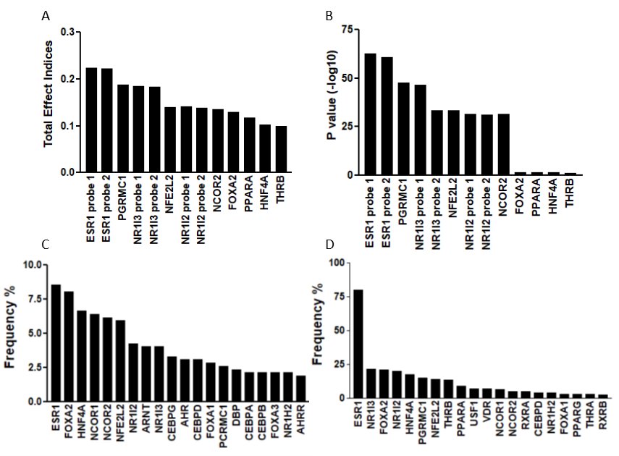
Interacting pairs
Interacting triplets
Figure 1

Slide 2
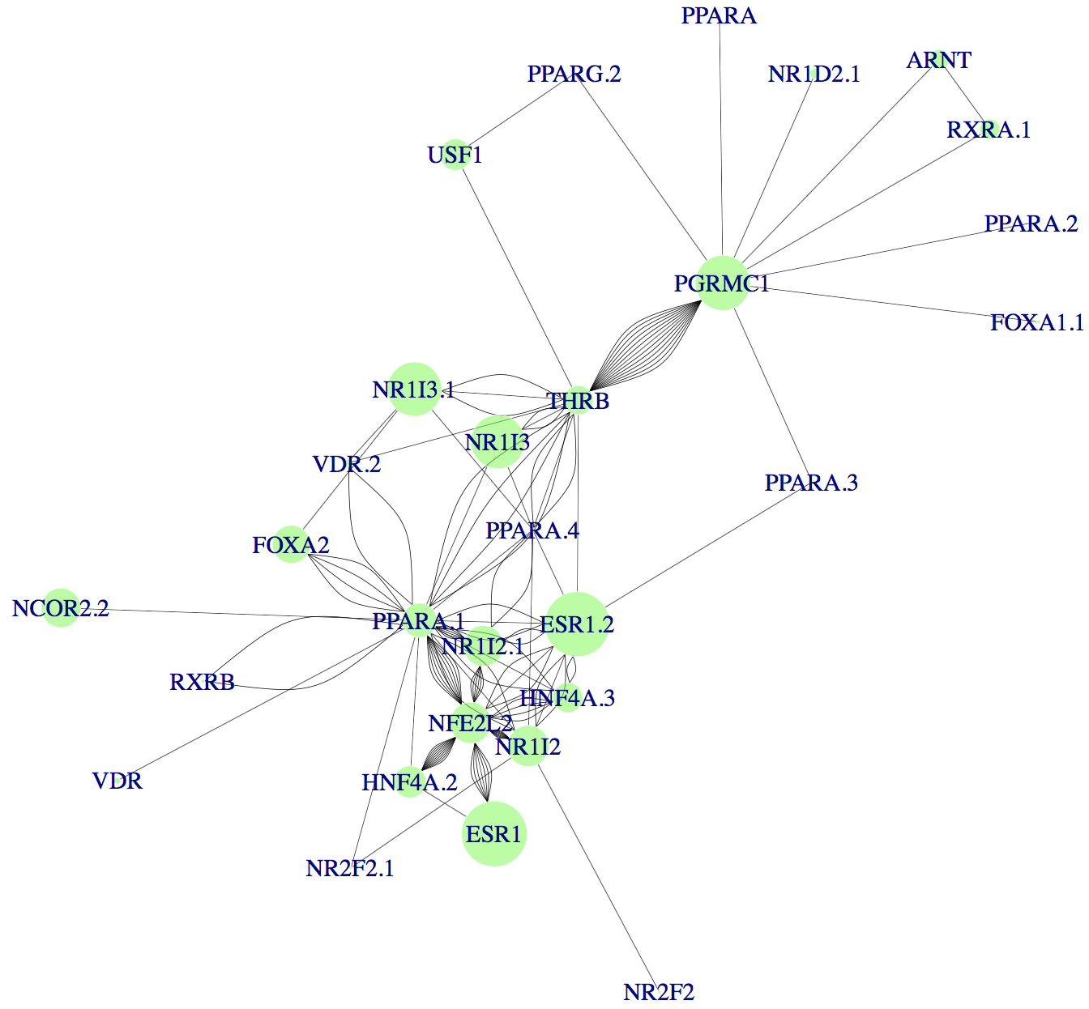
Figure 2

Slide 3
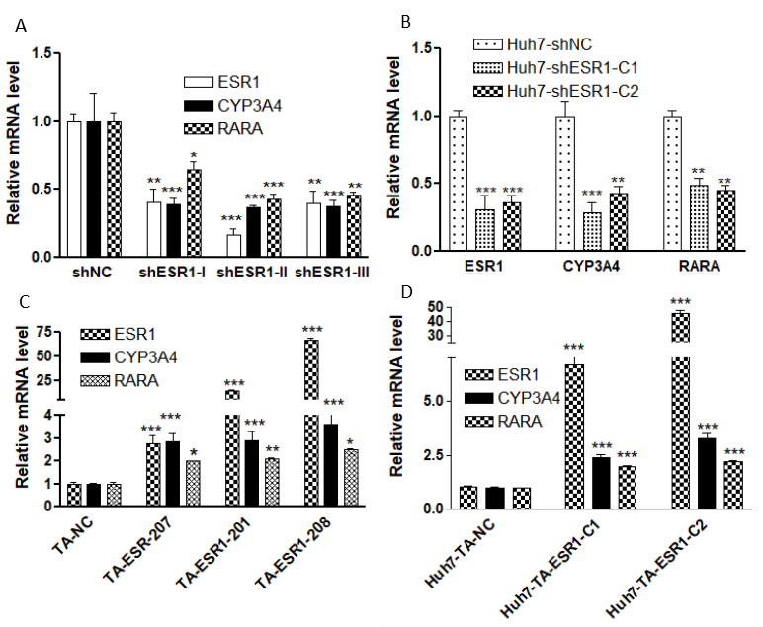
Figure 3

Slide 4
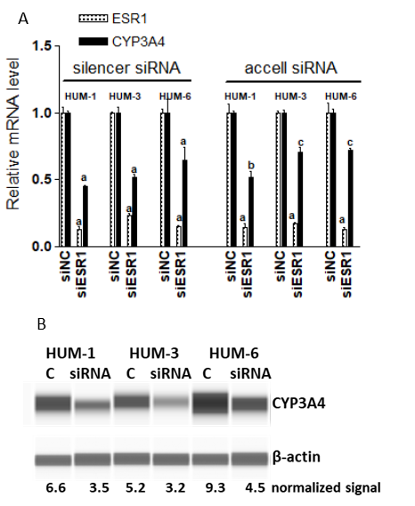
Figure 4

Slide 5
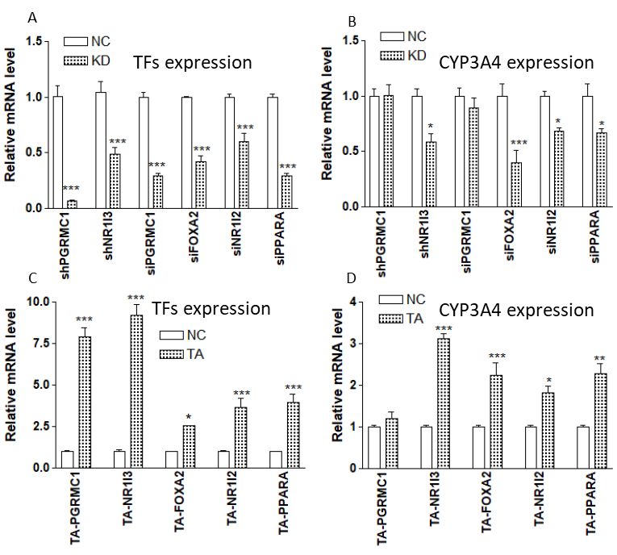
Figure 5

Slide 6
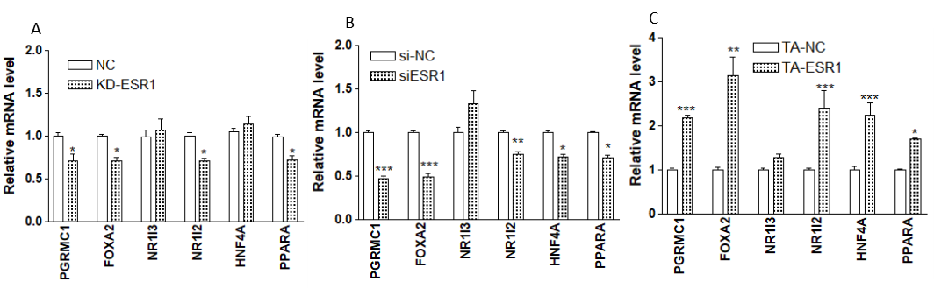
Figure 6

Slide 7
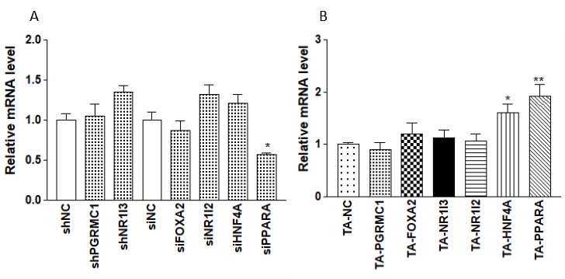
Figure 7

Slide 8
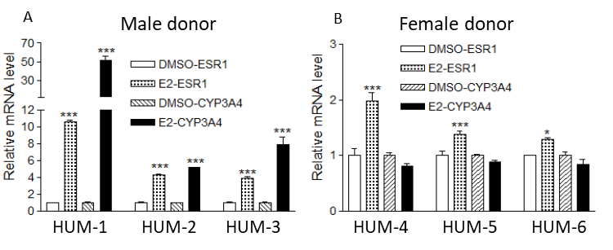
Figure 8

Slide 9
Figure 9

